Slide 1



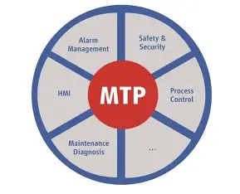
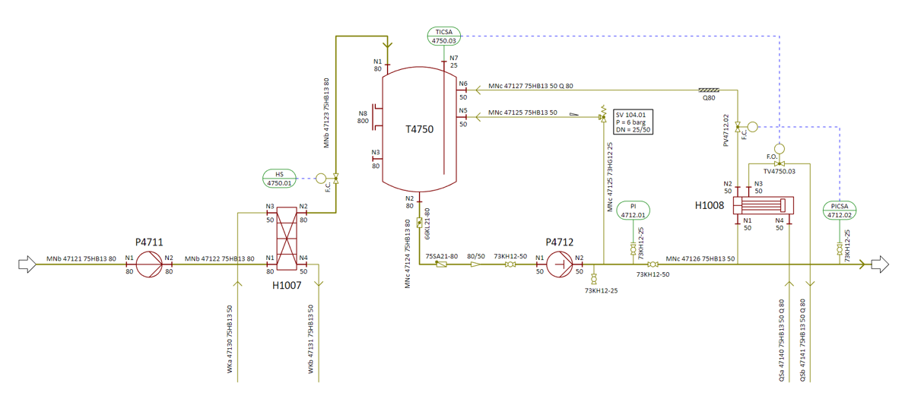
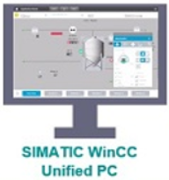
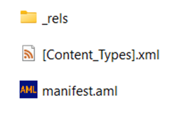

Auto HMI Engineering from DEXPI files
Data extraction
Data mapping
MTP generator
DEXPI Files
Extract Process components
Mapping to MTP objects
MTP Generator
MTP Files
Generate I/O tag list
Define MTP services
P&ID drawings
MTP Files
DEXPI to MTP files

Slide 2
Agents in work for Auto generation

Slide 3
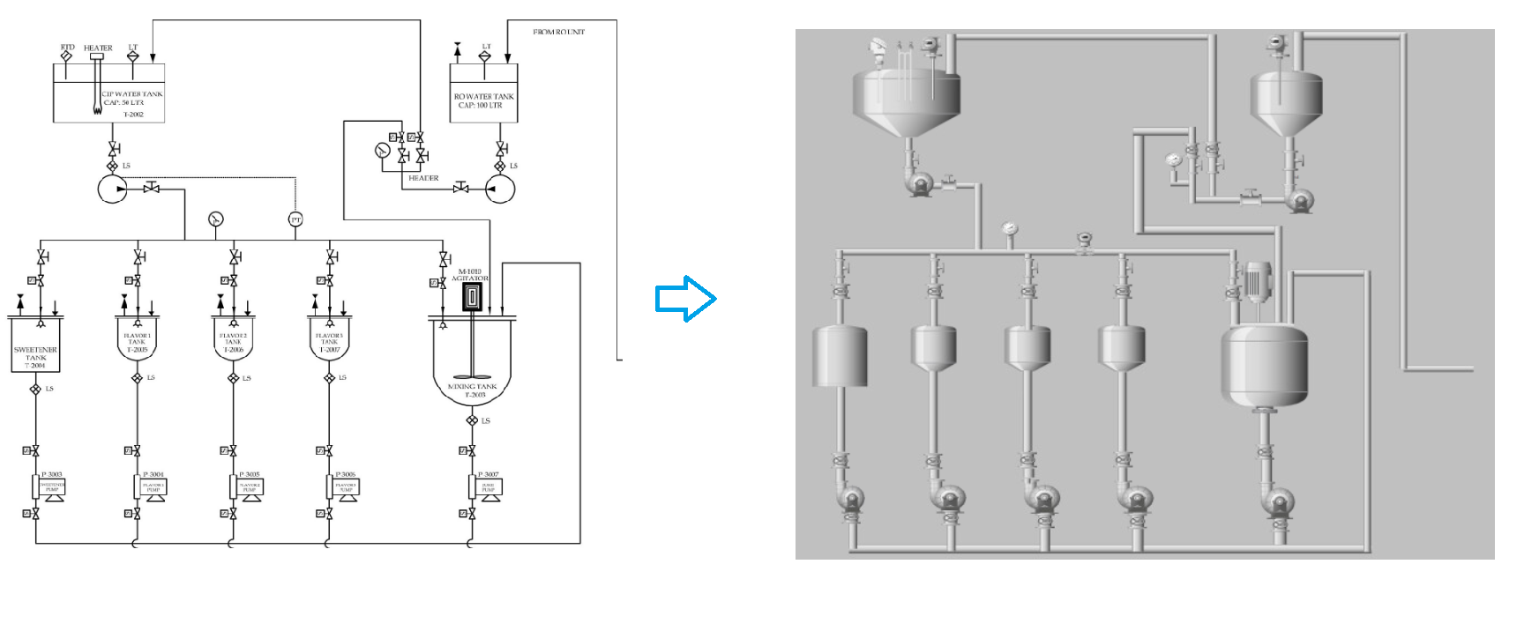
Generated HMI Screen

